Slide 1
Assessing Gender Bias in Artificial Intelligence

Slide 2
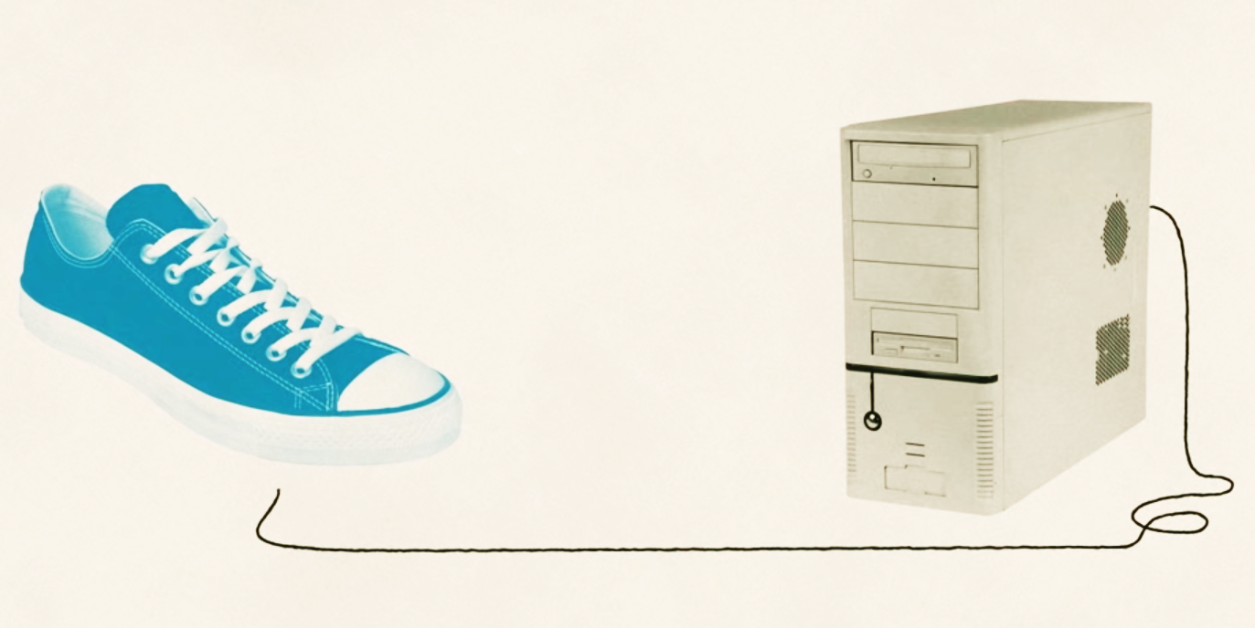
What are we talking about?
Notes:
https://phys.org/news/2018-11-amazon-sexist-hiring-algorithm-human.html

Slide 3
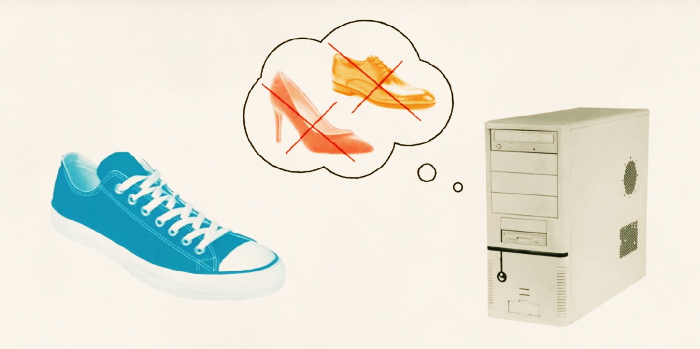
What are we talking about?

Slide 4
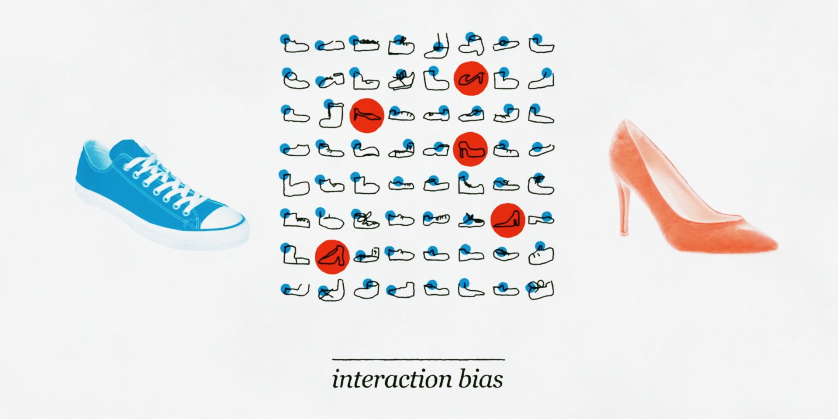
What are we talking about?

Slide 5
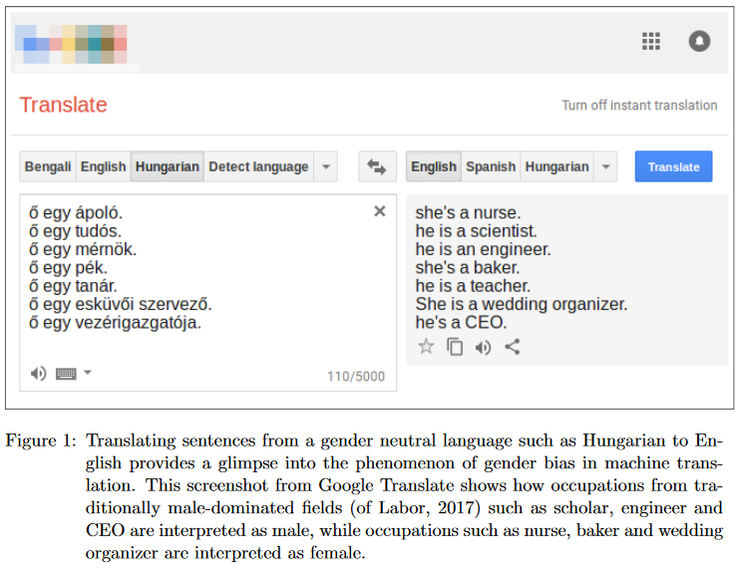
Introduction
Notes:
In medicine, machine-learning predictors can be particularly vulnerable to biased training sets, because medical data are especially costly to produce and label. Last year, researchers used deep learning to identify skin cancer from photographs. They trained their model on a data set of 129,450 images, 60% of which were scraped from Google Images3. But fewer than 5% of these images are of dark-skinned individuals, and the algorithm wasn’t tested on dark-skinned people. Thus the performance of the classifier could vary substantially across different populations.

Slide 6
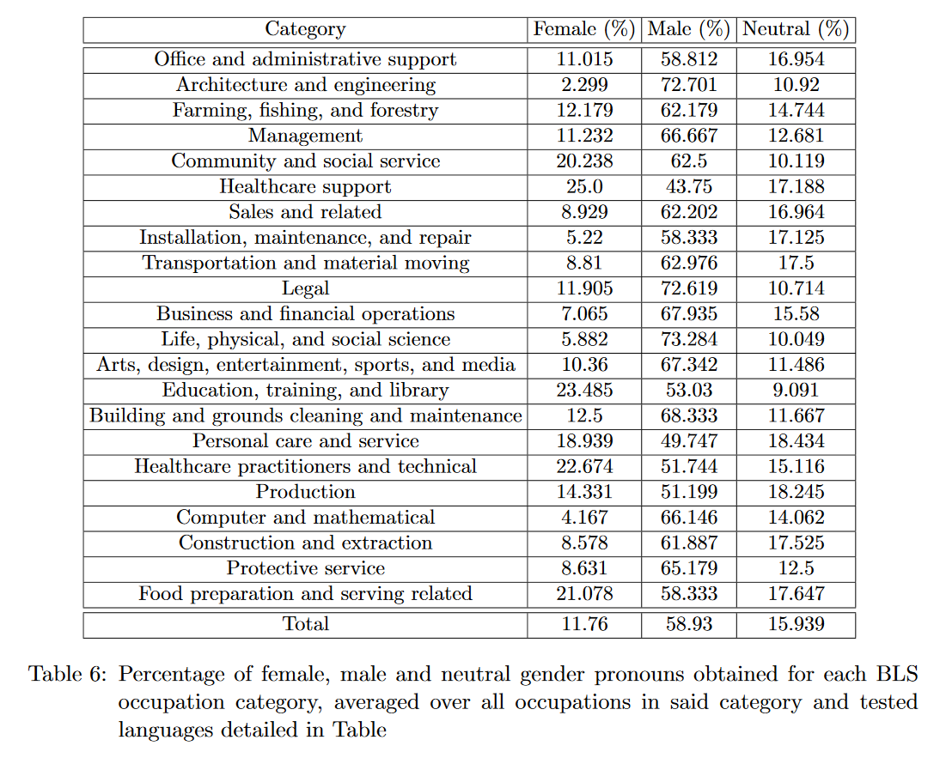
Introduction
Notes:
In medicine, machine-learning predictors can be particularly vulnerable to biased training sets, because medical data are especially costly to produce and label. Last year, researchers used deep learning to identify skin cancer from photographs. They trained their model on a data set of 129,450 images, 60% of which were scraped from Google Images3. But fewer than 5% of these images are of dark-skinned individuals, and the algorithm wasn’t tested on dark-skinned people. Thus the performance of the classifier could vary substantially across different populations.

Slide 7
Case #1: A Cell Phone that Can Diagnose Cancer
How?
A computer trained to identify images of skin cancer moles and lesions as accurately as 21 board-certified dermatologists…
129,450 images
2,000 skin diseases
Why?
Low-cost universal access to diagnostic care.
6.3 billion subscriptions by 2021
Notes:
5% of these images are of dark-skinned individuals, and the algorithm wasn’t tested on dark-skinned people. Thus the performance of the classifier could vary substantially across different populations.

Slide 8
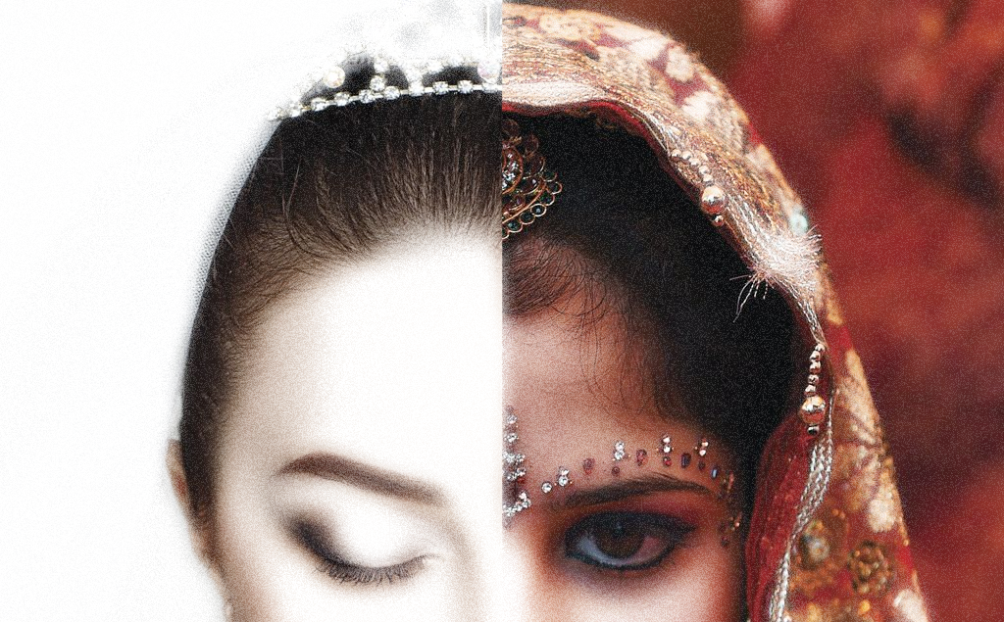
Case #1: A Cell Phone that Can Diagnose Cancer
What’s the issue?
The algorithm wasn’t tested on dark-skinned people. The performances could vary across different populations.
95%
of white people images
Notes:
5% of these images are of dark-skinned individuals, and the algorithm wasn’t tested on dark-skinned people. Thus the performance of the classifier could vary substantially across different populations.

Slide 9
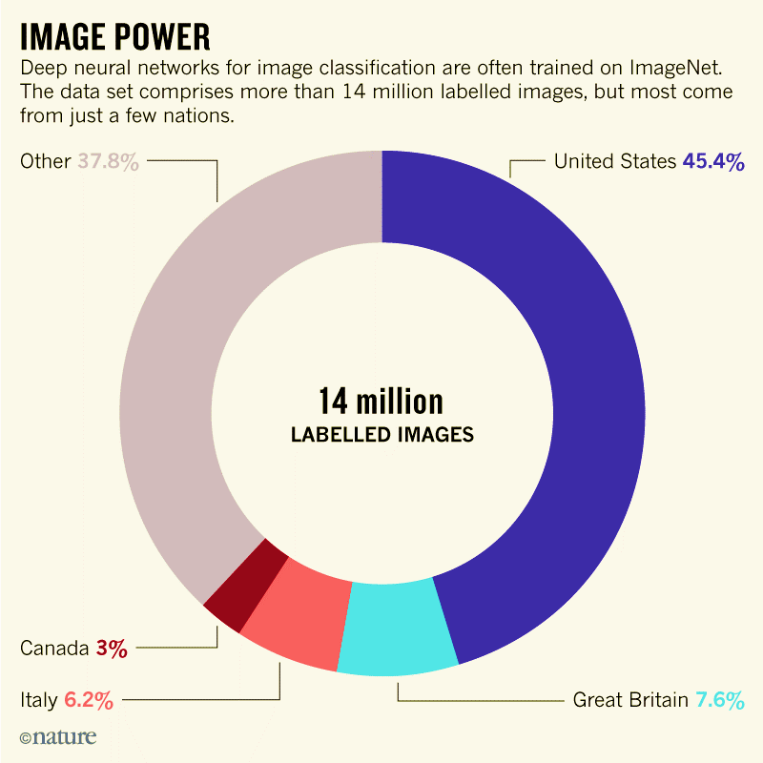
The data source
Notes:
5% of these images are of dark-skinned individuals, and the algorithm wasn’t tested on dark-skinned people. Thus the performance of the classifier could vary substantially across different populations.

Slide 10
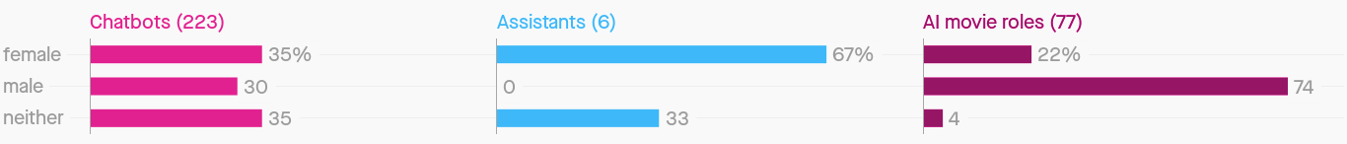
Case #2: Alexa, make me a sandwich
95% of the human assistants are females,
What about AI assistants?
Notes:
5% of these images are of dark-skinned individuals, and the algorithm wasn’t tested on dark-skinned people. Thus the performance of the classifier could vary substantially across different populations.
Finally, at the time, 27 per cent of American CEOs were women, but only 11 per cent of the Google image results for “CEO” were women (not including Barbie).

Slide 11
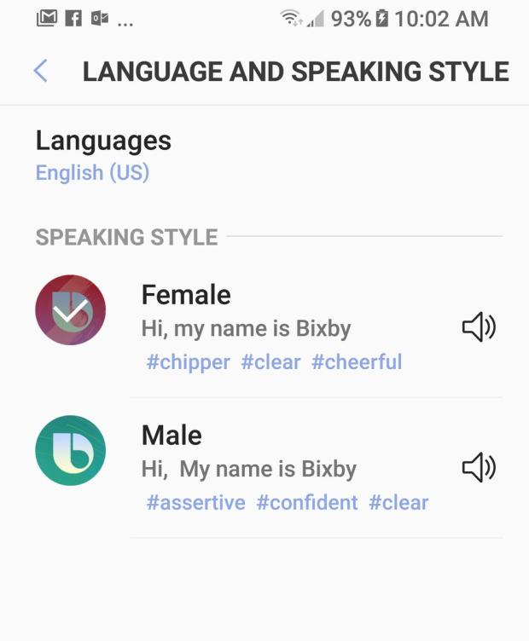
Case #2
How do they see themselves?

Slide 12
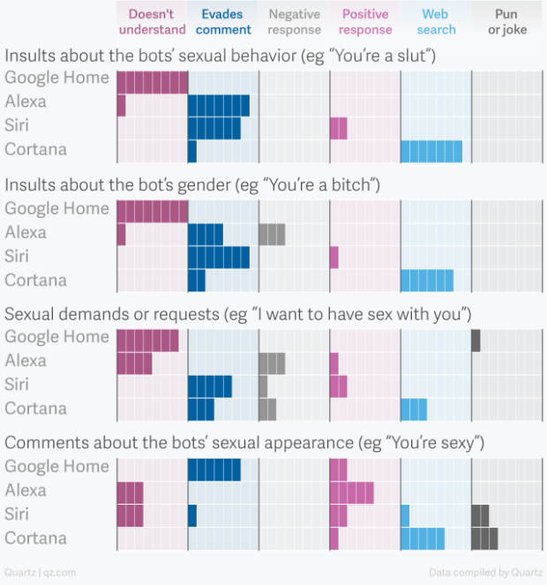
Case #2
How do they react to stereotypes?

Slide 13
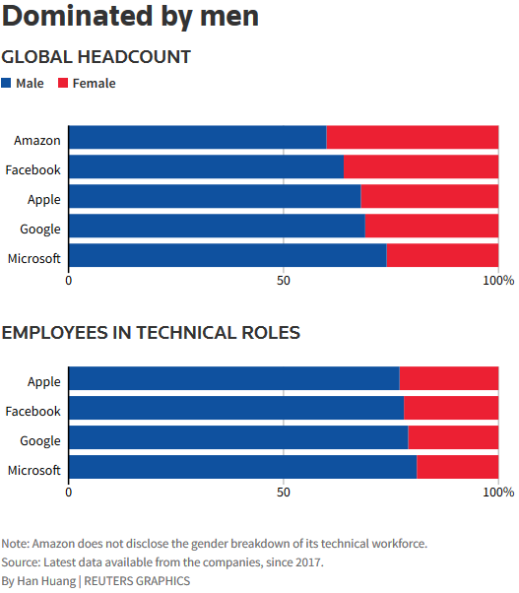
Case #3: Amazon’s AI Recruitment Tool
How?
Amazon’s computer models were trained to vet applicants by observing patterns in resumes submitted to the company over a 10-year period.
10 years of Amazon, INC. data
What’s the issue?
Did not manage to find a way to make the tool gender-neutral because it gets stuck on:
men domination in companies and masculine language (terms).

Slide 14
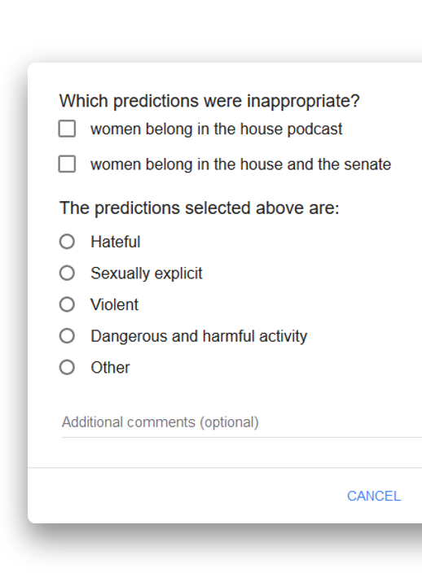
The problem, or the cure?
It’s impossible to prevent human bias It’s part of the technology created.
Give correction tools to every human “Report inappropriate predictions”

